Slide 1
Trakx Token
(TRKX)

Slide 2
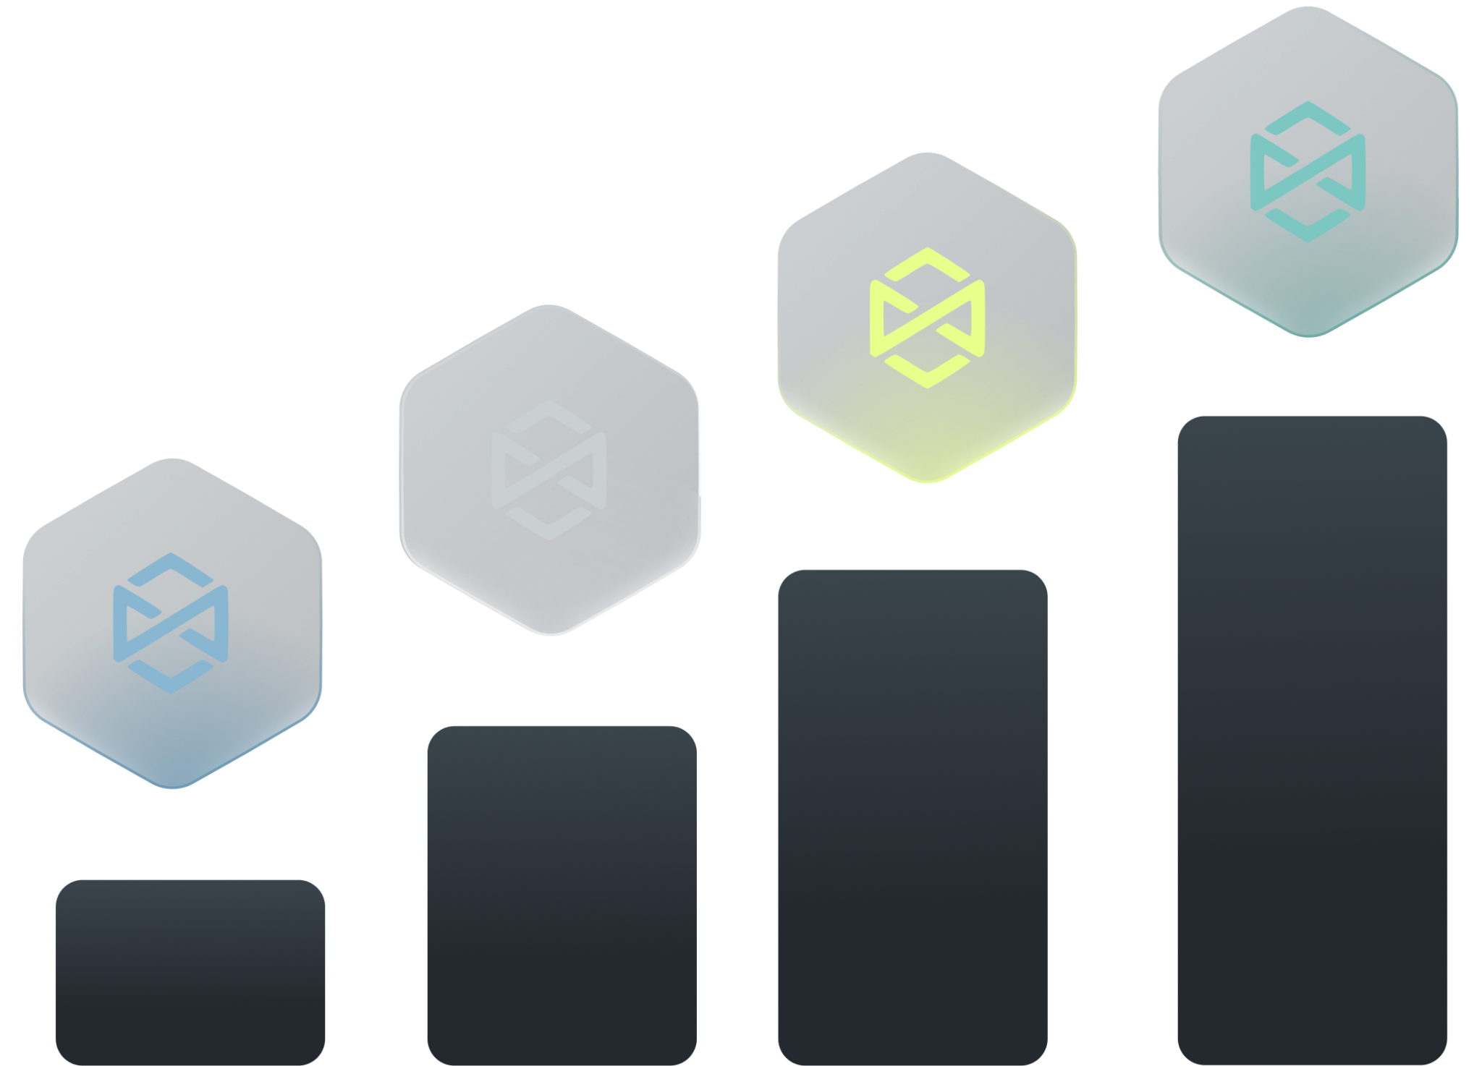
Trakx token utility
The Trakx token, TRKX, is a key tool to grow the Trakx retail ecosystem. It will provide its users with access to a wide range of advantages and benefits, including:
Discount programs: up to 50% discount on trading fees, depending upon the amount of TRKX tokens staked
Referral programs: from 20% to 35% fees redistributed for referrals, depending upon the amount of TRKX tokens staked
Grant programs: active community members will receive grants in TRKX tokens in exchange for specific actions & services (e.g. deposits and/or CTI purchases or trading competition…)
Governance: our community will get the opportunity to play an important role in key decisions, such as grant programs
Buyback and burn programs: 20% of the revenues derived from the retail trading business will be put in a vault and discretionarily used to buyback the TRKX tokens
Higher API trading rate
Other perks: priority access to new products (ie. alpha and bespoke products) & dedicated services (white glove, managed accounts…)

Slide 3
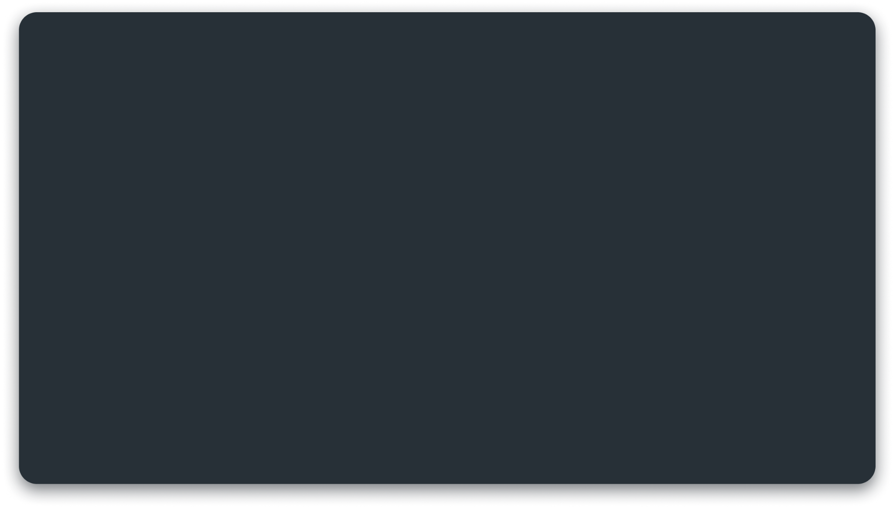
Discount on fees
The Trakx discount program is composed of an eight tier system based on the Trakx token holdings and gives up to 50% trading discount.
The fee schedule depends on the total of TRKX traded volume during the preceding 30-day period (in USD equivalent). Thus, the benefits start at the end of the 30-day holding period and recalibrate every 30 days.
Tier | TRKX staked (USD equivalent)* | Discount on Taker & Maker Fees
Regular 1 | $0 | 0%
Regular 2 | > $100 | 5%
Regular 3 | > $1,000 | 10%
Regular 4 | > $10,000 | 20%
Vip 1 | > $50,000 | 25%
VIP 2 | > $200,000 | 30%
VIP 3 | > $1,000,000 | 40%
VIP 4 | > $5,000,000 | 50%
On the basis of 1 TRKX= 0.06 USD

Slide 4
Referral program
Up to 35% fee redistribution
If a new user registers using a referee's unique referral code, the referee will receive 20%–35% of their fees, and the referred user will receive a 5% refund. The referee will benefit from the fee redistribution for one month only.
Level | TRKX staked (USD equivalent)* | Fee redistribution rates
Level 1 | $0 | 20%
Level 2 | > $250 | 22%
Level 3 | > $500 | 24%
Level 4 | > $1,000 | 26%
Level 5 | > $10,000 | 28%
Level 6 | > $50,000 | 30%
Level 7 | > $250,000 | 32%
Level 8 | > $1,000,000 | 35%
On the basis of 1 TRKX=0.06 USD

Slide 5
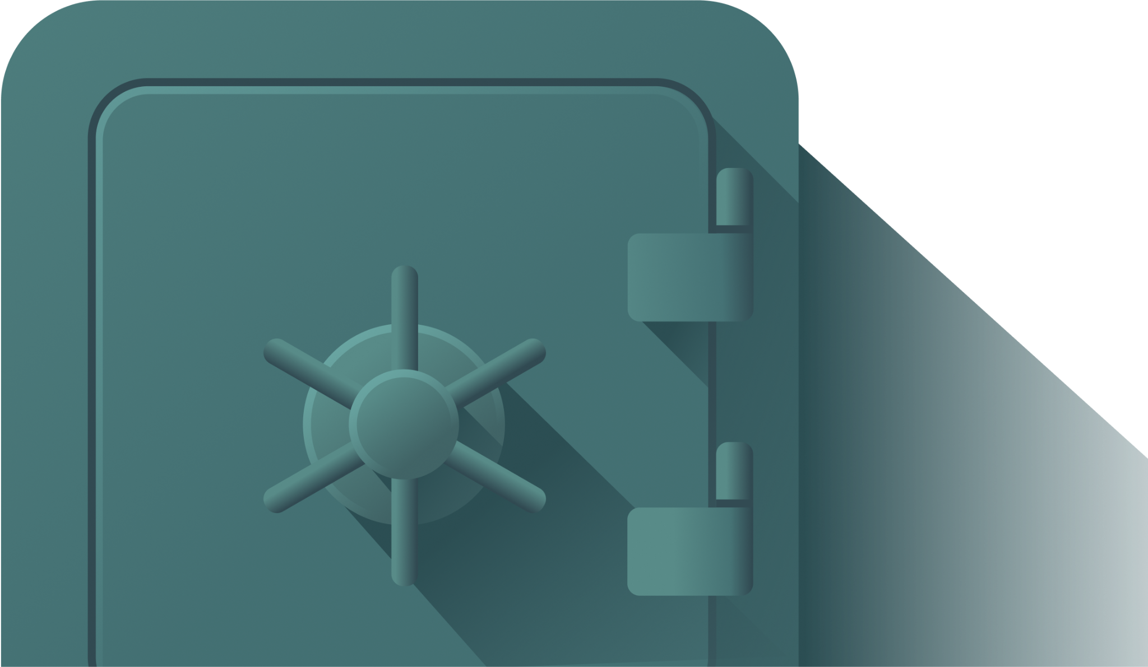
Governance
Along with economic benefits, the TRKX token will play an important role in the Trakx ecosystem governance.
TRKX token holders will have the right to vote on key proposals, such as incentive programs, grant programs, allocation of TRKX tokens, allocation of fees generated by the platform.
Holders will be able to delegate their tokens to the most active community members.

Slide 6
Buyback and burn program
Through our buyback and burn program, Trakx is committed to supporting both the value of its token and the project’s long-term success.
20% of the revenue derived from the retail trading business will be transferred into a vault, comprising both stablecoins and TRKX tokens
This vault will be used to buyback or sell TRKX tokens on the markets when required. This model aims at ensuring that the TRKX public price is in line with the value perceived by long term TRKX holders
Buyback programs will not occur on a recurring basis. Like for listed equities, internal research will be required to assess the value for long term holders and the timing of buyback programs

Slide 7
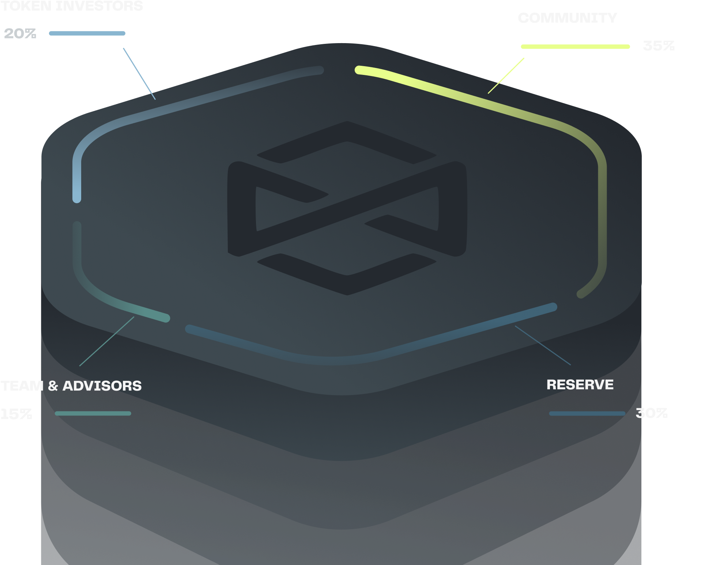
TRKX distribution
The TRKX token distribution follows industry best practices
Our community will receive the largest share and will be incentivized and rewarded with targeted airdrops, discount & referral programs

Slide 8
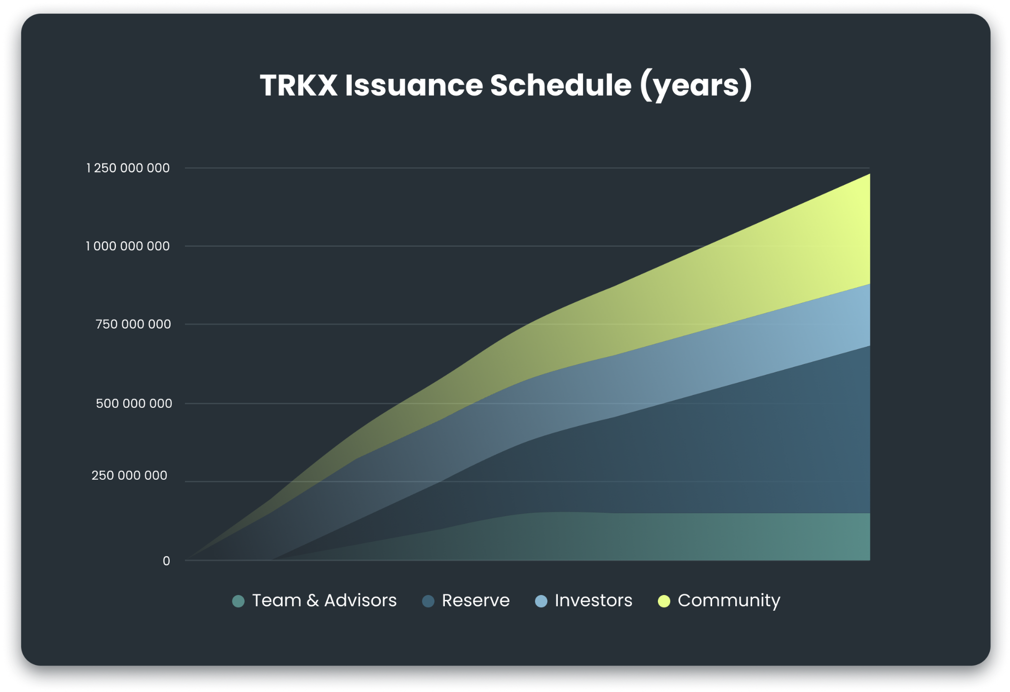
TRKX issuance schedule
To align individual interests with the long term success of Trakx, our team members will undergo the longest vesting period of 36 months
Vesting from investors in the private sale will range from 6 to 18 months
Tokens will be gradually distributed to the community over 8 years, ensuring a smooth project decentralization

Slide 9
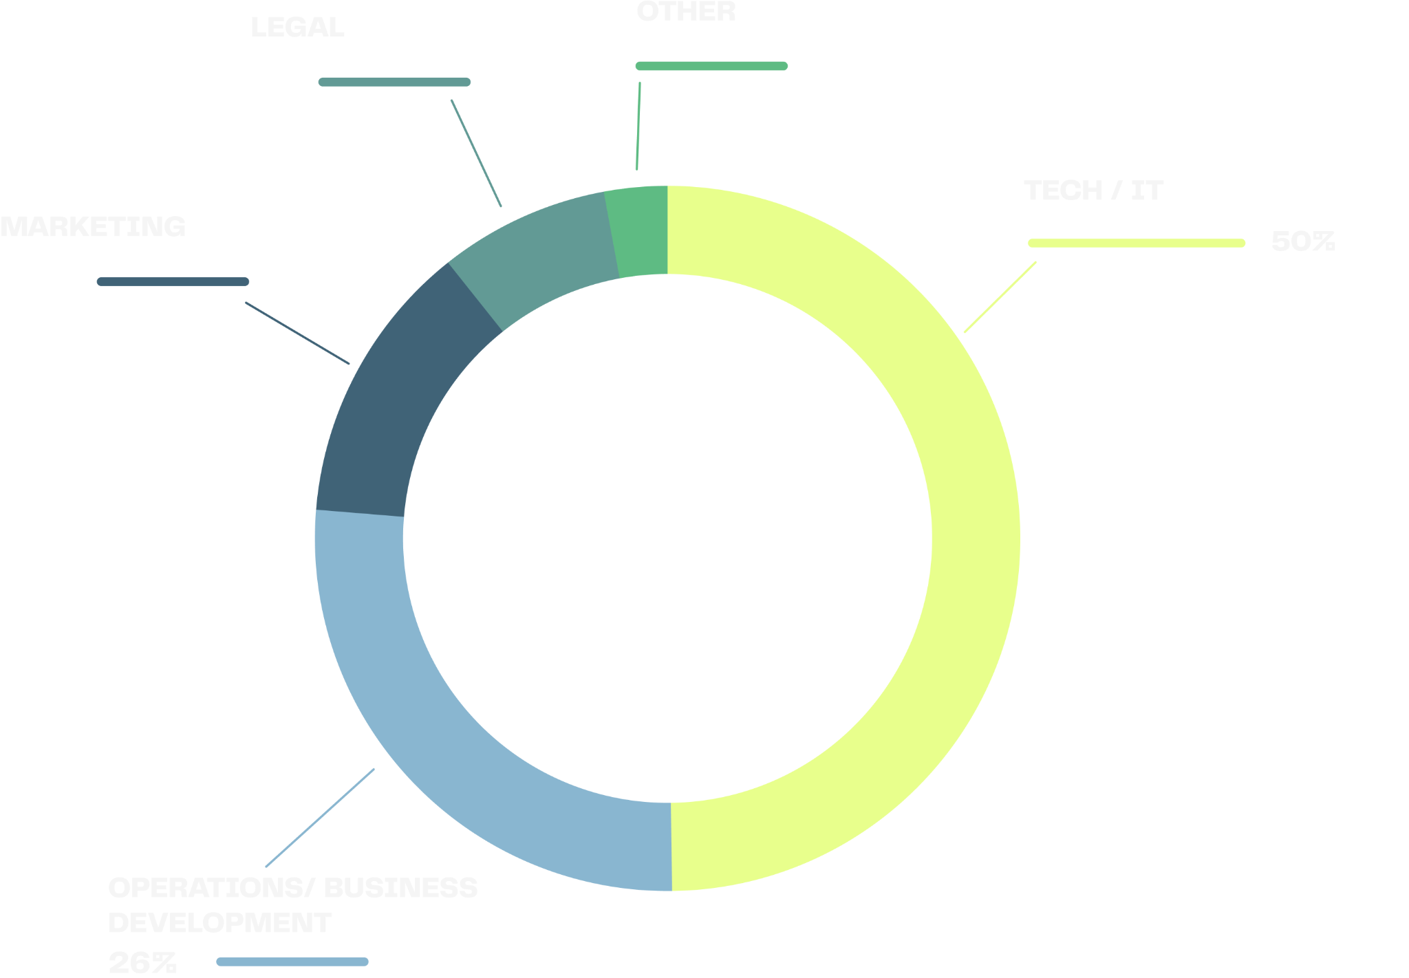
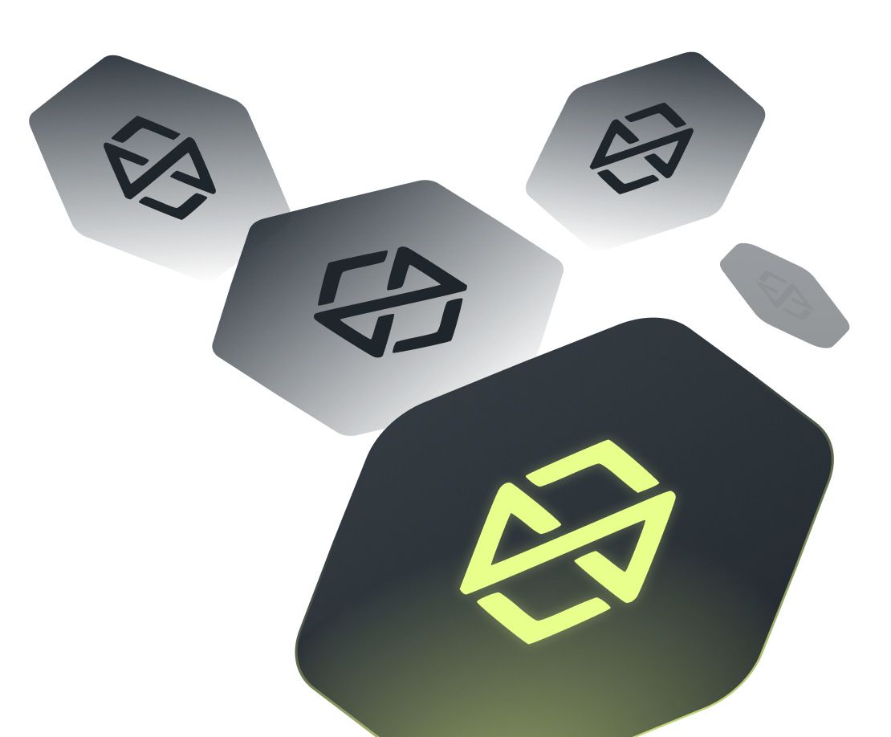
TRKX use of proceeds

Slide 10
TRKX lifecycle
Trakx team is committed to offer a best-in-class token strategy through the TRKX lifecycle, in line with industry standards:
Listing: making TRKX available on secondary markets (both centralized & decentralized exchanges) – talks already engaged with reputable centralized exchanges
OTC desk: opening a dedicated desk for large over-the-counter trades
Market-making: ensuring the TRKX token is liquid and spreads are low on secondary markets – talks already engaged with external market-makers
Buyback & Buffer Model: 20% of trading fees will be transferred into a vault comprising both of stablecoins and TRKX tokens. This vault will be used to buyback or sell TRKX tokens on the market when required. This model will aim at ensuring that the TRKX public price is in line with the value perceived by long-term TRKX holders

